Slide 1
Social network models of diffusion
(Global) Threshold models (Granovetter 1978; Macy 1991)
Critical Mass Models (Marwell et al 1988; Macy 1990)
Diffusion via cohesion and opinion leaders (Coleman et al 1966; Rogers 1962)
Diffusion via positional equivalence (Burt 1987)
Weak ties as necessary for diffusion (Granovetter 1982)
Network Threshold Models (Valente 1996)

Slide 2
Social network models of diffusion
(Global) Threshold models (Granovetter 1978; Macy 1991)
Critical Mass Models (Marwell et al 1988; Macy 1990)
Diffusion via cohesion and opinion leaders (Coleman et al 1966; Rogers 1962)
Diffusion via positional equivalence (Burt 1987)
Weak ties as necessary for diffusion (Granovetter 1982)
Network Threshold Models (Valente 1996)

Slide 3
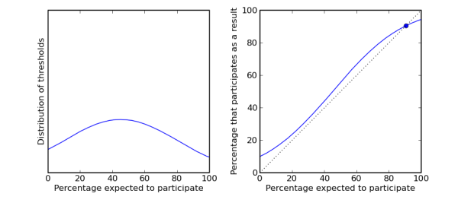
Network threshold models
In the (global) threshold model of diffusion (Granovetter 1978) takes q (the probability of adoption/participation):
  is equivalent to the proportion of persons in the system that have already adopted/participated
  is unique for each person in the system q(i) subject to some distribution

Slide 4
Network threshold models
In the (global) threshold model of diffusion (Granovetter 1978) takes q (the probability of adoption/participation):
  Persons with low thresholds are high risk early adopters
  Persons with high thresholds are risk averse late adopters

Slide 5
Network threshold models
In the (global) threshold model of diffusion (Granovetter 1978) takes q (the probability of adoption/participation):
  Variance in thresholds explains the typical S-shaped pattern of cumulative adoptions with initial slow uptake, rapid spread and slow saturation.

Slide 6

Social network models of diffusion
Ryan, B. and N.C. Gross (1943) The Diffusion of Hybrid Seed Corn in Two Iowa Communities, Rural Sociology, 8: 15-24.

Slide 7

Social network models of diffusion
Rogers, E.M.(1962) The Diffusion of Innovations, Free Press, New York.

Slide 8
Social network models of diffusion
The Innovators and Early adopters are individuals whose time-of-adoption is greater than one standard deviation earlier than the average time-of-adoption.
The early and late majorities are individuals whose time-of-adoption is bounded by one standard deviation earlier and later than the average.
Laggards are those individuals who adopted later than one standard deviation from the mean

Slide 9
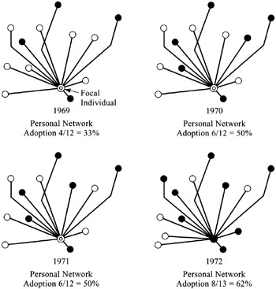
Network threshold models
The network threshold model relaxes the assumption that persons have global information on all adoptions in the system
  Global threshold models are appropriate for adoptions of behaviors that are public and observable

Slide 10
Network threshold models
However, may be inappropriate for the adoption of innovations that are not directly observable
Individuals may monitor only a subset of actors in the system, namely those that they are connected to

Slide 11
Network threshold models
Particularly appropriate when adoption behavior entails uncertainty and risk
An individual's exposure is given by the proportion of her neighbors that have already adopted

Slide 12
Network threshold models
Each individual is endowed with a given threshold q(i)
  When the proportion of neighbors who have adopted equals q(i), the person adopts
  We can then redefine adopter categories (e.g. innovators) as either
    System relative
    Network relative

Slide 13
Network threshold models
Early adopters (or laggards) relative to their network may not be early adopters relative to the system
  For instance, if a high q individual's network is composed entirely of innovators, he will be a laggard relative to his peers but an innovator relative to the system

Slide 14
Network threshold models
Early adopters (or laggards) relative to their network may not be early adopters relative to the system
  In the same way a low-q individual who belongs to an isolated clique will be a laggard relative to the system but an early adopter relative to his peers

Slide 15
Network threshold models
A key finding in classic diffusion research is that early adopters are more likely to have external (media, weak ties) sources of influence, while late adopters are more subject to network effects (Rogers 1962)
  This seems to reflect a local/Cosmopolitan split
Considering both system-level and personal network threshold clarify this relationship
  Cosmopolitan innovators tend to be early adopters relative to the system and have very low threshold relative to their network

Slide 16
Network threshold models
The network threshold model allows to come up with a more nuanced classification of early and late adopters
System Threshold
Low High
Low
High
True innovators (influentials) | Isolates
Connected Bandwagon | Resistant rearguard
Network Threshold

Slide 17
Network threshold models
Opinion leaders are relative to their system-level adopter category:
  Early adopters who convince those with high network thresholds (but similar system threshold) to adopt
System Threshold
Low High
Low
High
True innovators (influentials) | Isolates
Connected Bandwagon | Resistant rearguard
Network Threshold

Slide 18
Complex versus simplex contagion
We have seen that heterogeneity in the propensity to adopt an innovation can be modeled as a threshold process
However, thresholds may not be fixed for individuals regardless of what is being diffused
Instead, persons may modulate their thresholds depending on characteristics of the innovation that is being transmitted through the network

Slide 19
Complex versus simplex contagion
Innovations that entail risk, ostracism, potential loss of resources, may elicit higher thresholds from all actors in the network
  Persons require exposure to multiple sources to adopt
Innovations (e.g. gossip) that carry little risk may in their turn elicit a very low threshold
  In the limiting case, the person adopts as soon as one of their neighbors adopts

Slide 20
Complex versus simplex contagion
Innovations that entail risk, ostracism, potential loss of resources, may elicit higher thresholds from all actors in the network
  Persons require exposure to multiple sources to adopt
This is the difference between simplex and complex contagion
  The basic idea is that certain innovations can only diffuse via complex contagion

Slide 21
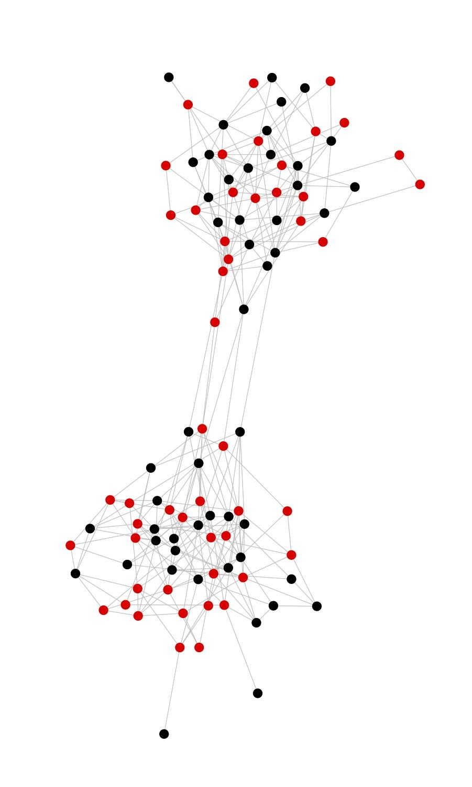
Complex versus simplex contagion
Examples of simplex contagion:
  Information, disease
Examples of complex contagion:
  High risk social movement participation, religious conversion, migration, etc.

Slide 22
Complex versus simplex contagion
Four social mechanisms that require that innovations diffuse via complex contagion:
  Strategic complementarity: (adoption cost declines as a function of existing adopters)
  Legitimacy: Resistance to challenge, collective acceptance, and taken-for-grantedness increases in the number of adopters

Slide 23
Complex versus simplex contagion
Four social mechanisms that require that innovations diffuse via complex contagion:
  Credibility: Innovations appears are more trustworthy and less risky when high status members of the community also adopt
  Emotional contagion: Cumulative interaction with a large number of adopters leads persons to adopt

Slide 24
Complex versus simplex contagion
Weakness of long ties argument:
  Long ties might be appropriate for simplex diffusion
  However, they are not up to task when it comes to complex contagion
  The reason for this is that in addition to length, complex contagions require bridges to be wide

